Slide 1
Quantum Dots
Stephen Kelly

Slide 2
History
First discovered around 1982 by Alexey Ekimov
Term was coined in 1986
Also called “Artificial Atoms”
Notes:
Russian ad

Slide 3
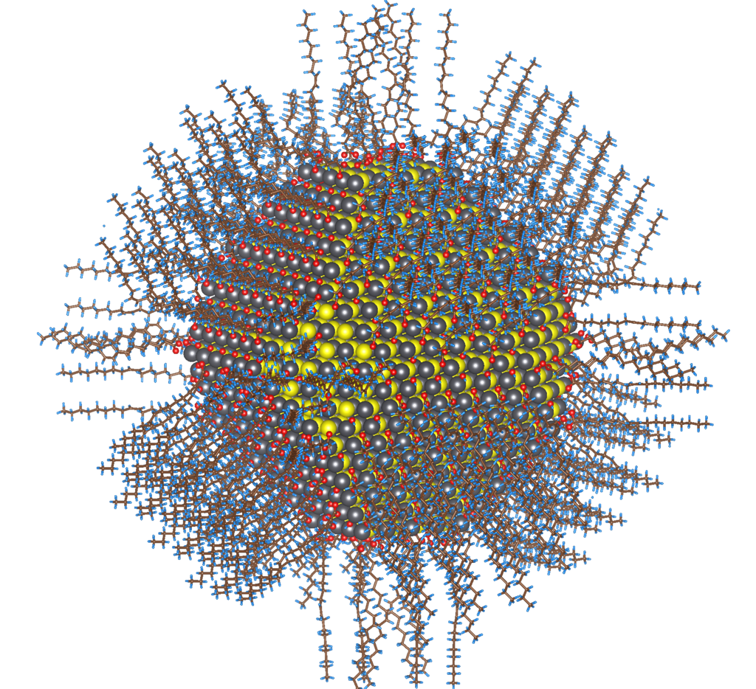

Slide 4
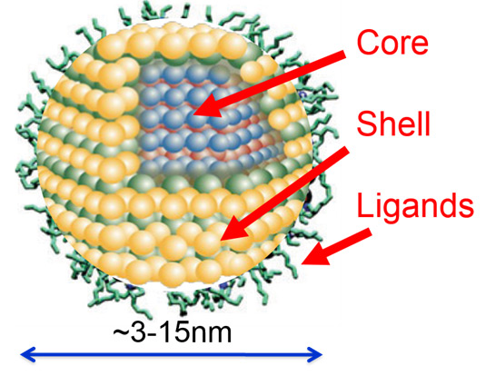
Image credit: http://www.photonics.com/images/spectra/features/2007/May/QuantumDots_Fig5_CoreShell.jpg

Slide 5
Properties
Relatively precise control of photon emission/absorption wavelength
  Smaller R -> smaller wavelength, and vice versa
Formed via colloidal synthesis
  Inkjet and spincoating
  Low cost
High quantum yield or “one-for-two” exchange

Slide 6
Materials
Cadmium Sulfide (CdS)
Cadmium Telleride (CdTe)
Lead Sulfide (PbS)
Copper Indium Sulfide (CuInS₂)
Gold Indium Sulfide (AgInS₂)
Zinc Sulfide (ZnS)

Slide 7
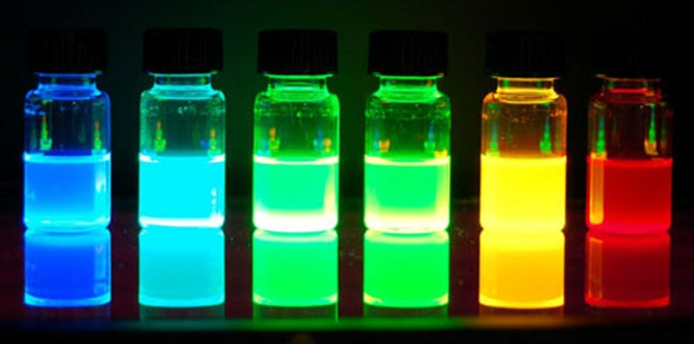

Slide 8
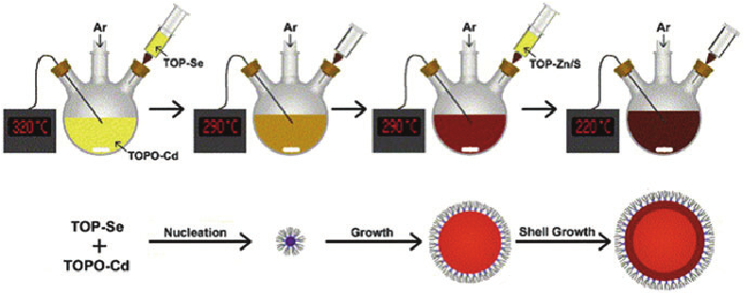
One-Pot Synthesis
Kango, Sarita & Kalia, Susheel & Thakur, Pankaj & Kumari, Bandna & Pathania, Deepak. (2014). Semiconductor–Polymer Hybrid Materials. 10.1007/12_2014_295.
Notes:
Trioctylphosphine oxide (TOPO) is an organophosphorus compound with the formula OP(C₈H₁₇)₃. Frequently referred to as TOPO, this compound is used as an extraction or stabilizing agent. It is an air-stable white solid at room temperature.
Need stabilizing agents, otherwise it is like solder wetting

Slide 9
Synthesis Benefits
Still based on growing crystals
Purity is governed by reagent quantity
Temperatures govern growth rates

Slide 10
Applications

Slide 11
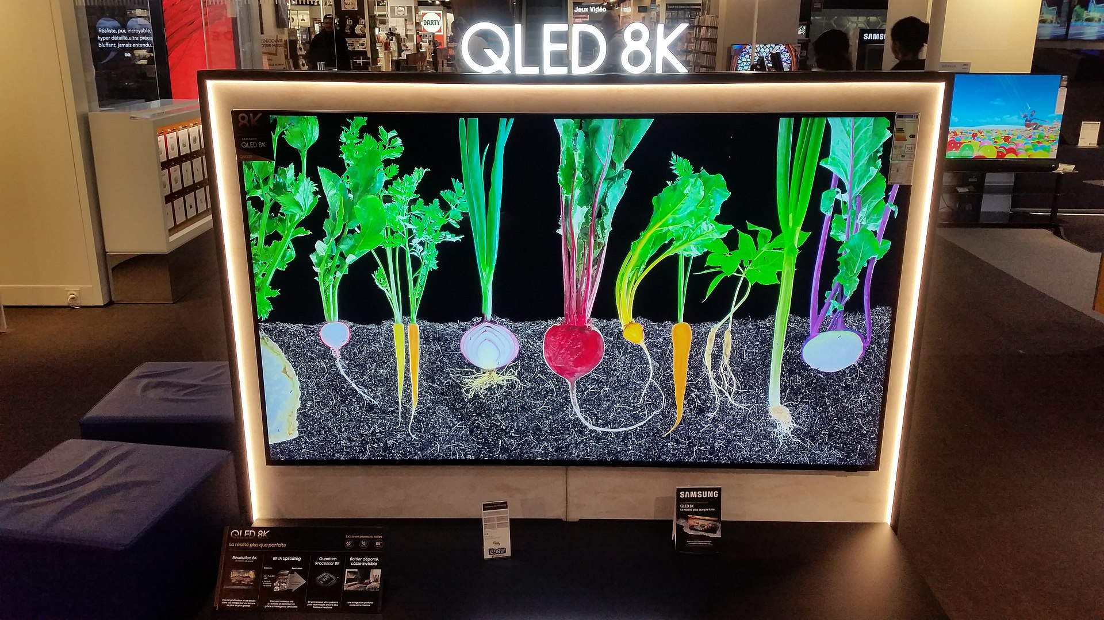

Slide 12
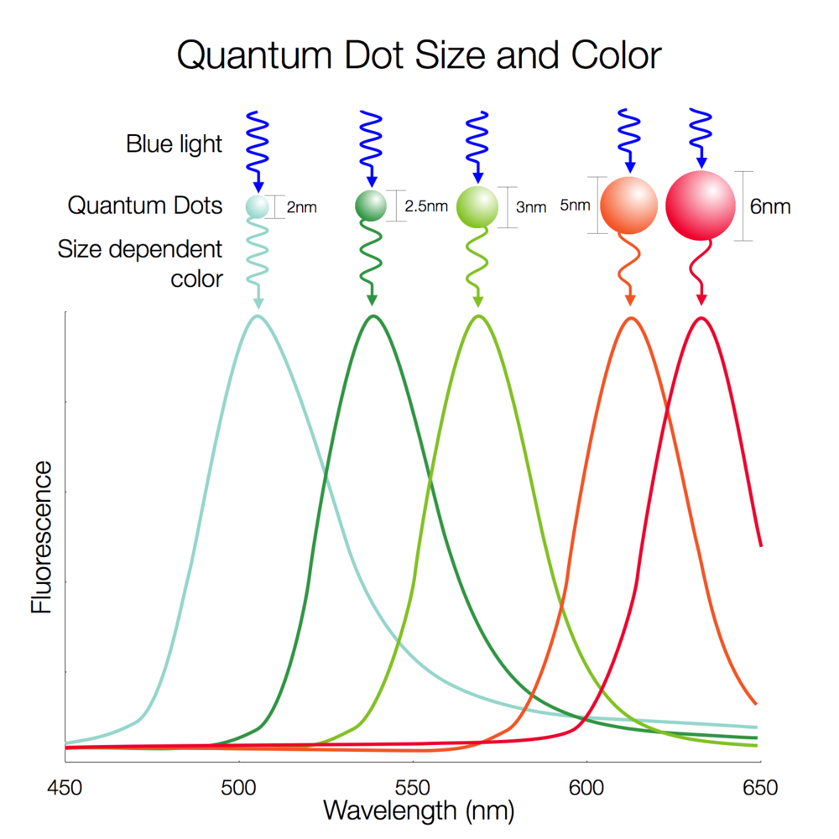
Nanosys Inc.

Slide 13
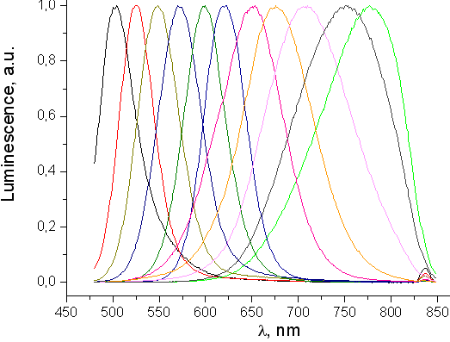
Luminescence spectra of CdTe quantum dots of different sizes from ca. 1 nm (left curve) to ca. 7 nm (green curve)

Slide 14
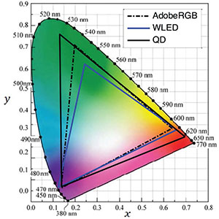
Shin-Tson Wu, University of Central Florida

Slide 15
Comparison to LED Binning

Slide 16
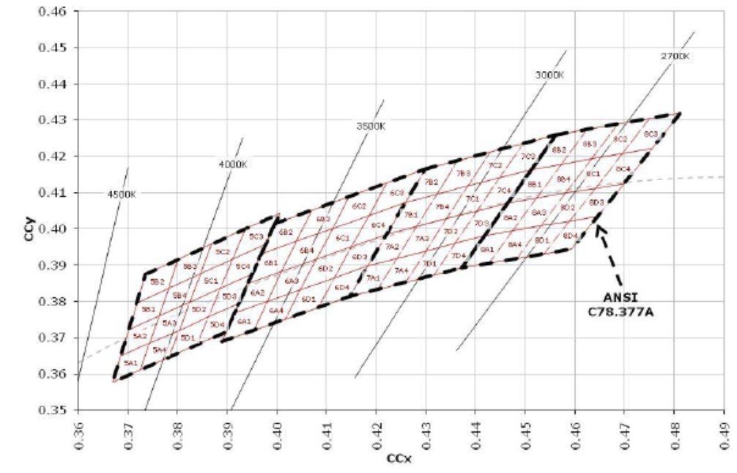
LED Binning

Slide 17
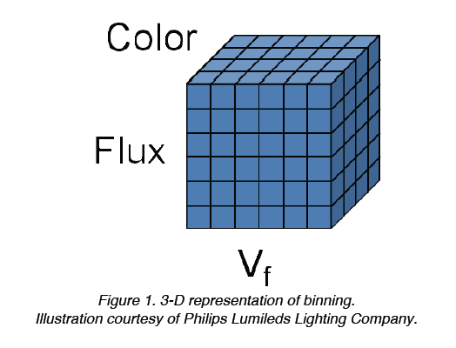
Notes:
Flux – Amount of light output
Color – Frequency of Light
Vf – applied voltage

Slide 18
LED Binning
Crystal growth is inconsistent
Doping locations are not controlled
Efficiency is sacrificed in certain color ranges

Slide 19
Quantum dots allows for improved precision, efficiency and output gamut

Slide 20
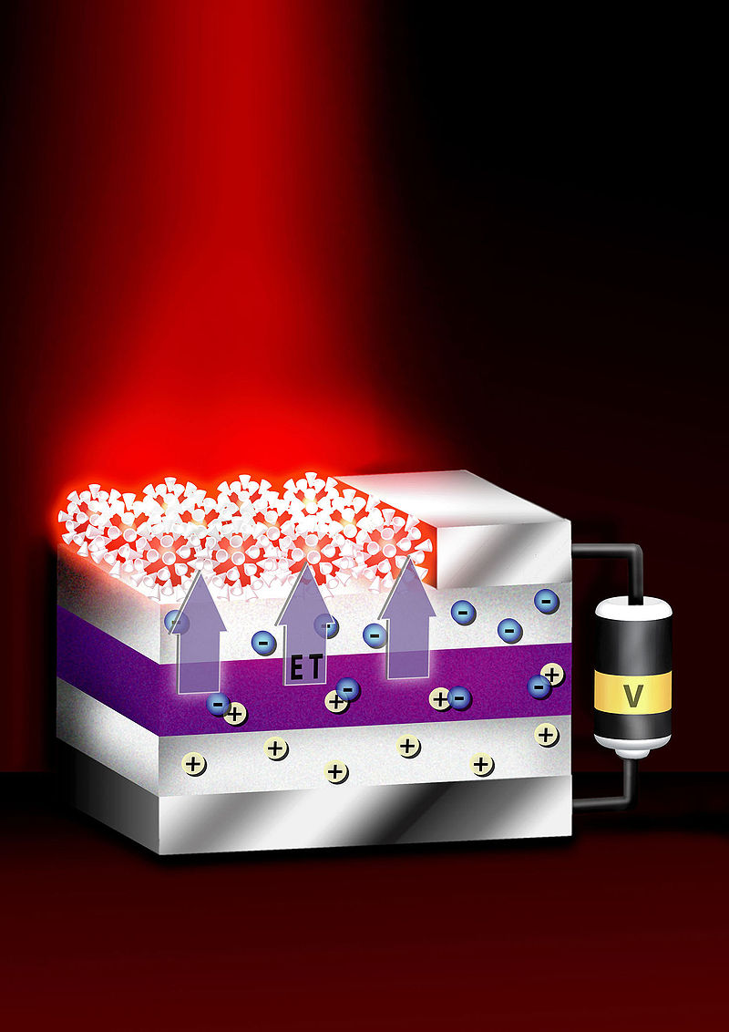
Quantum Dot Laser
Marc Achermann - Los Alamos National Laboratory, http://www.sandia.gov/news-center/news-releases/2004/micro-nano/well.html

Slide 21
Solar Applications

Slide 22
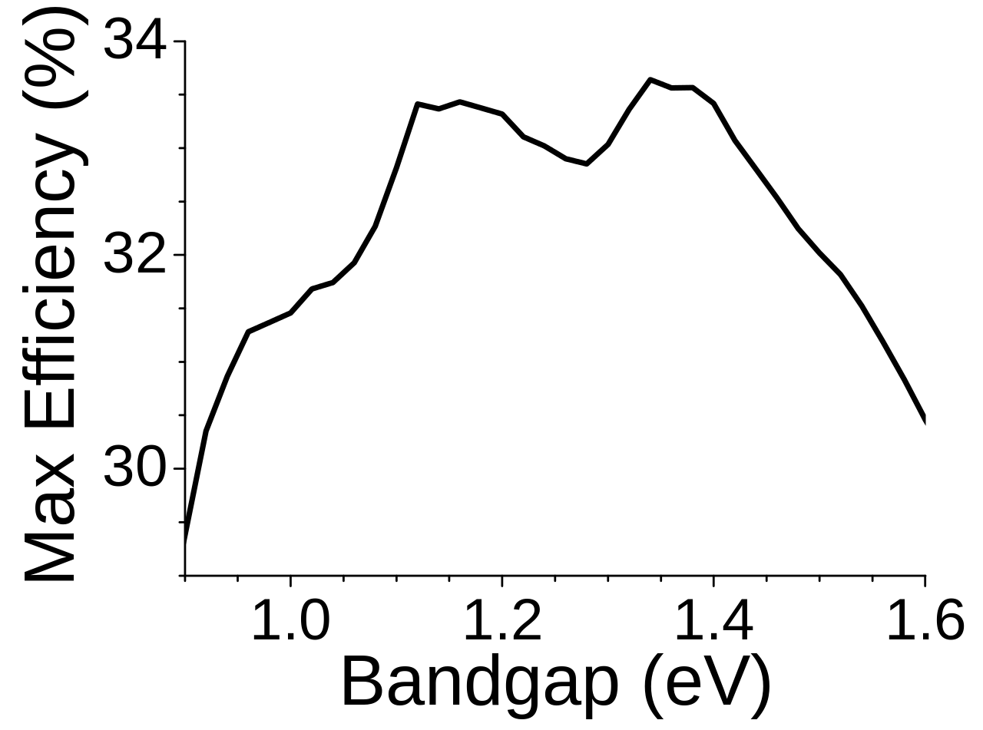
Shockley–Queisser limit

Slide 23
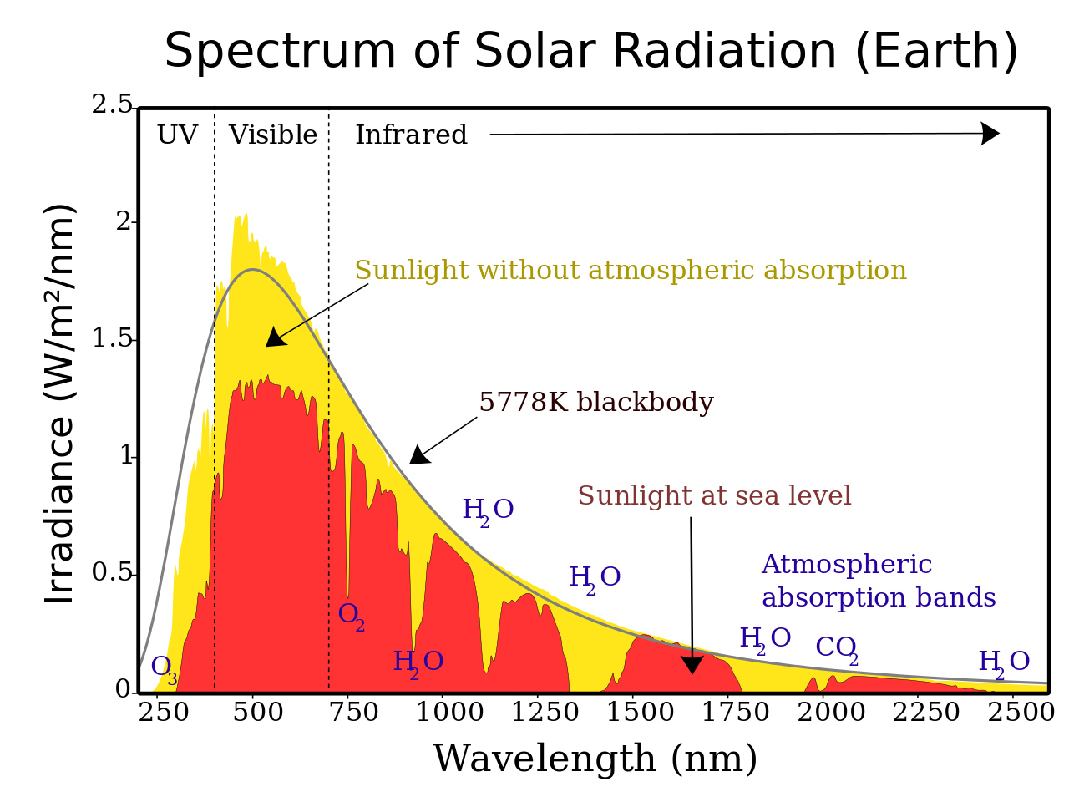

Slide 24
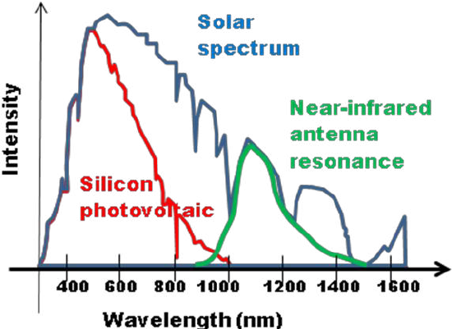

Slide 25
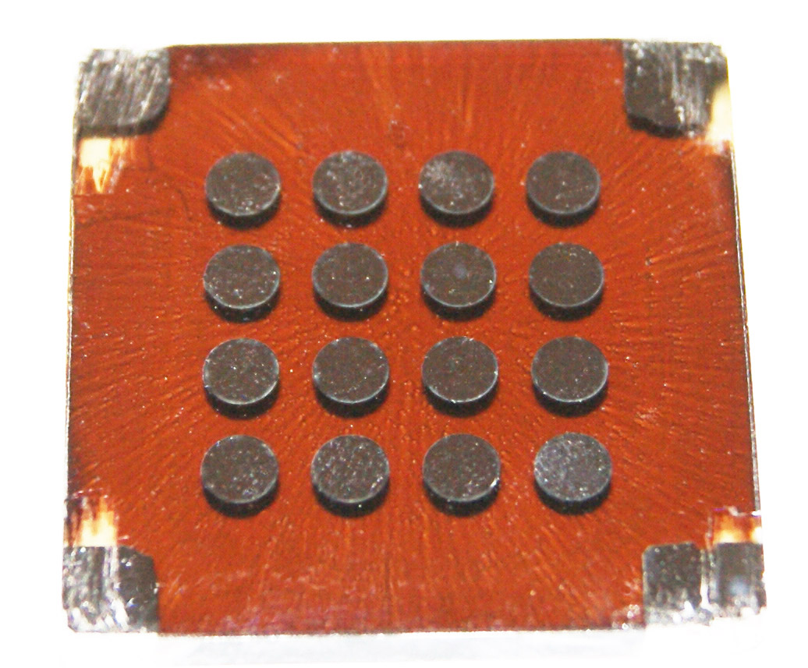
Lukasz Brzozowski - Lukasz Brzozowski, Director, Photovoltaics Research Program, Department of Electrical and Computer Engineering, University of Toronto

Slide 26
Biological

Slide 27
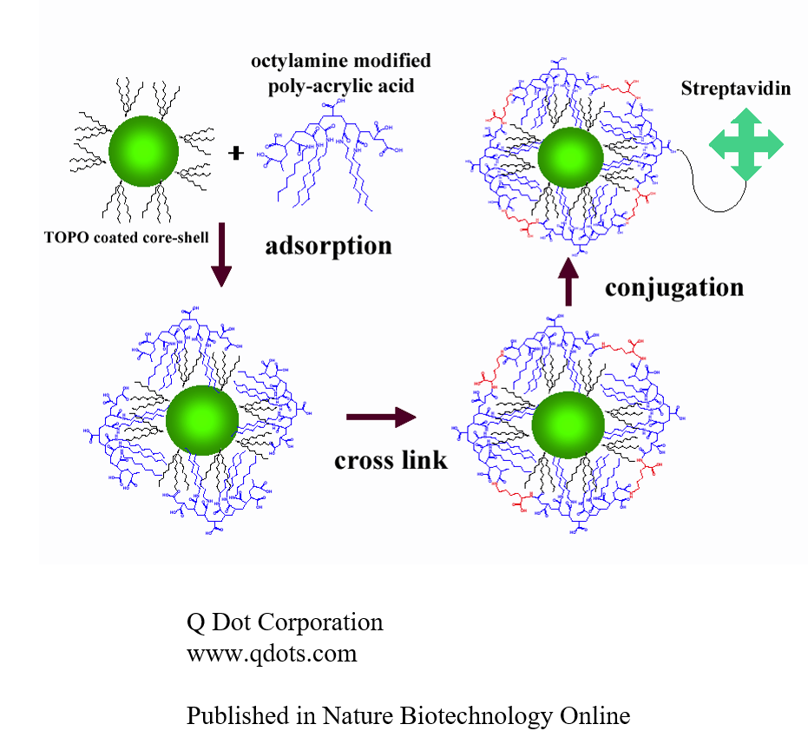
Immunohistochemistry

Slide 28
Physical Analysis

Slide 29
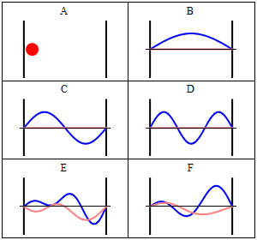
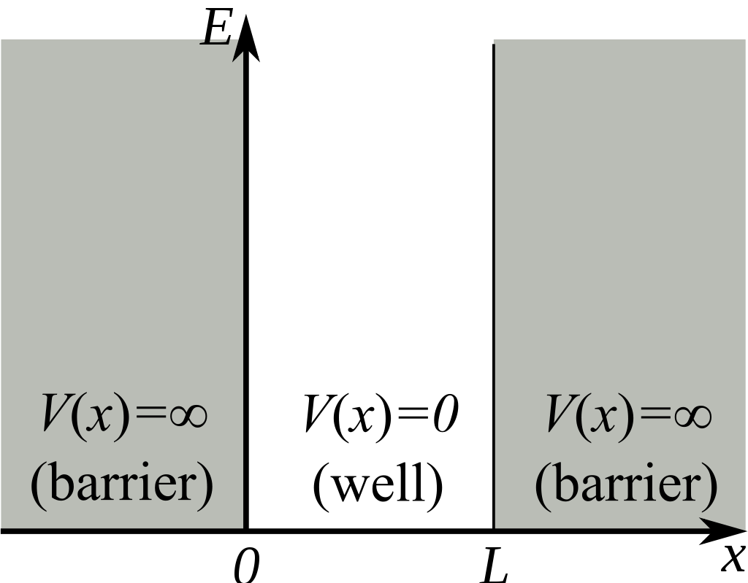
Particle in a Box

Slide 30

Brus Equation
  E_{gap} (CdSe) = 1.74 eV = 2.8·10⁻¹⁹ Joules,
  m_{e}* (CdSe) = 0.13 m_{e} = 1.18·10⁻³¹ kg,
  m_{h}* (CdSe) = 0.45 m_{e} = 4.09·10⁻³¹ kg.
  h = plancks constant (6.62607004 × 10⁻³⁴ m² kg / s)
  r = radius of QD
Notes:
The Brus equation^{[1]} can be used to describe the emission energy of quantum dot semiconductor nanocrystals (such as CdSe nanocrystals) in terms of the band gap energy E_{gap}, Planck's constant h, the radius of the quantum dot r, as well as the effective mass of the excited electron m_{e}* and of the excited hole m_{h}*.
The radius of the quantum dot affects the wavelength of the emitted light due to quantum confinement, and this equation describes the effect of changing the radius of the quantum dot on the wavelength λ of the emitted light (and thereby on the emission energy ΔE = hc/λ, where c is the speed of light). This is useful for calculating the radius of a quantum dot from experimentally determined parameters.
The overall equation is^{[2]}
E_{gap}, m_{e}*, and m_{h}* are unique for each nanocrystal composition. For example, with CdSe nanocrystals:
E_{gap} (CdSe) = 1.74 eV = 2.8·10⁻¹⁹ Joules,
m_{e}* (CdSe) = 0.13 m_{e} = 1.18·10⁻³¹ kg,
m_{h}* (CdSe) = 0.45 m_{e} = 4.09·10⁻³¹ kg.
E= h c/lambda

Slide 31
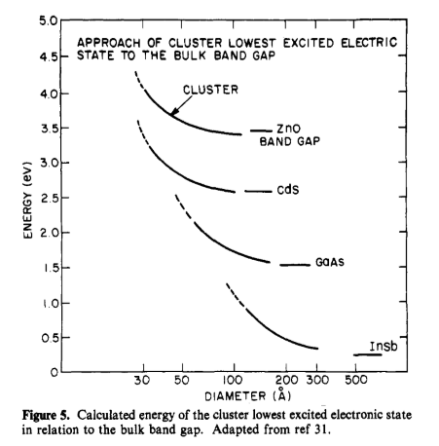
Brus, Louis. “Electronic Wave Functions in Semiconductor Clusters: Experiment and Theory.” The Journal of Physical Chemistry 90, no. 12 (June 1986): 2555–60. https://doi.org/10.1021/j100403a003.

Slide 32
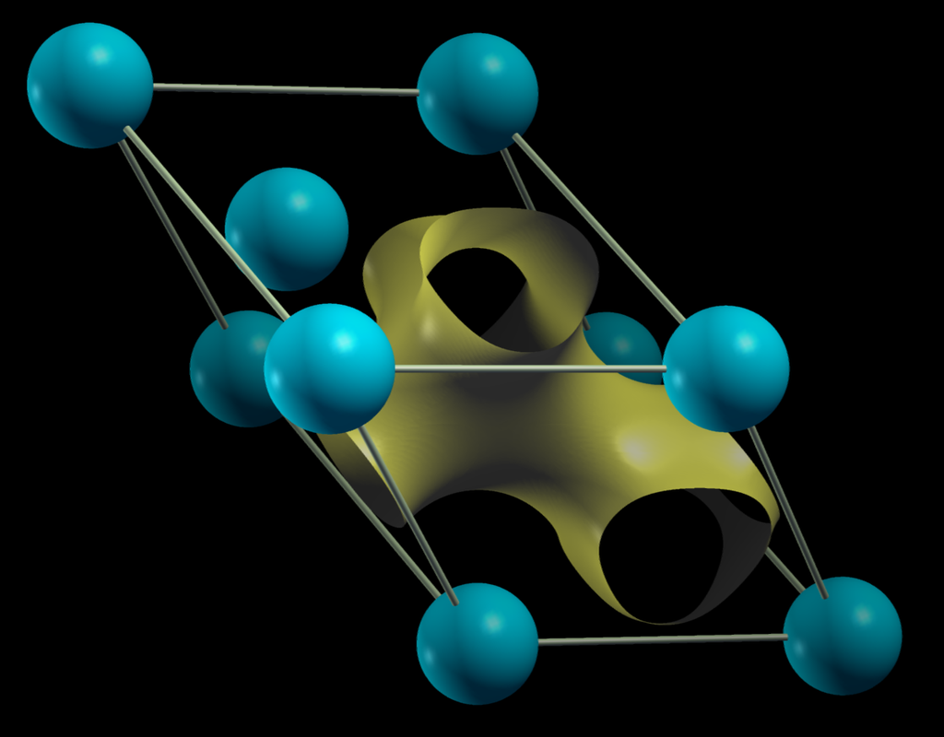
Bloch Wave

Slide 33
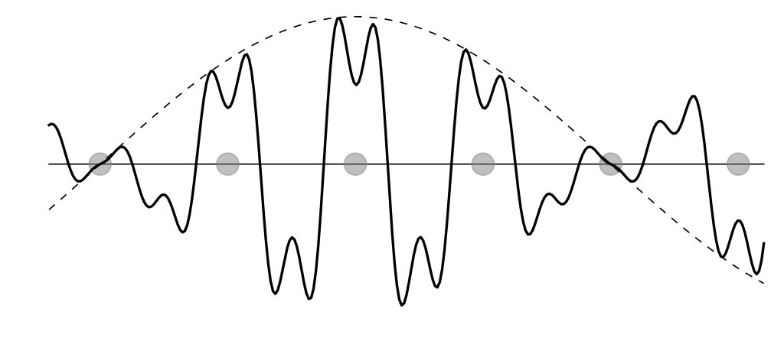
Block Wave

Slide 34
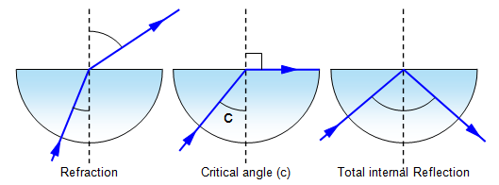
Evanescent Waves

Slide 35
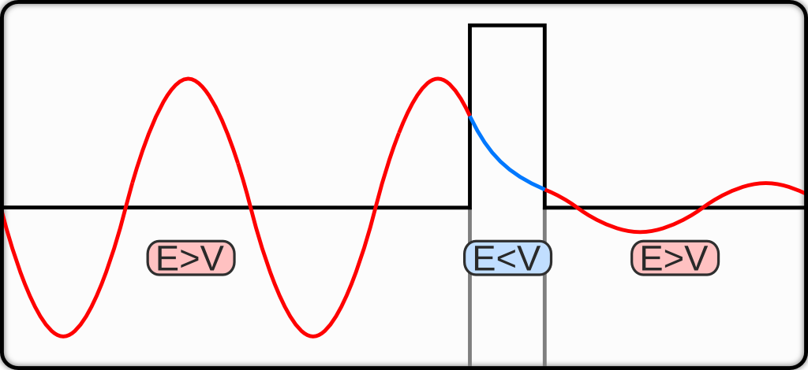
Evanescent Waves (Quantum Tunneling)
Felix Kling

Slide 36
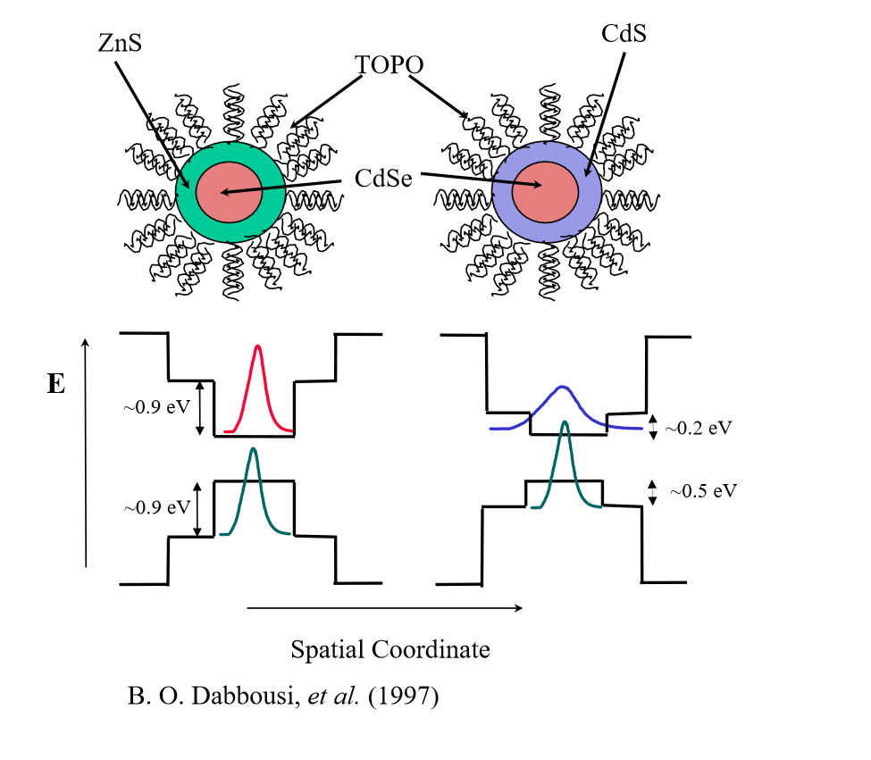

Slide 37
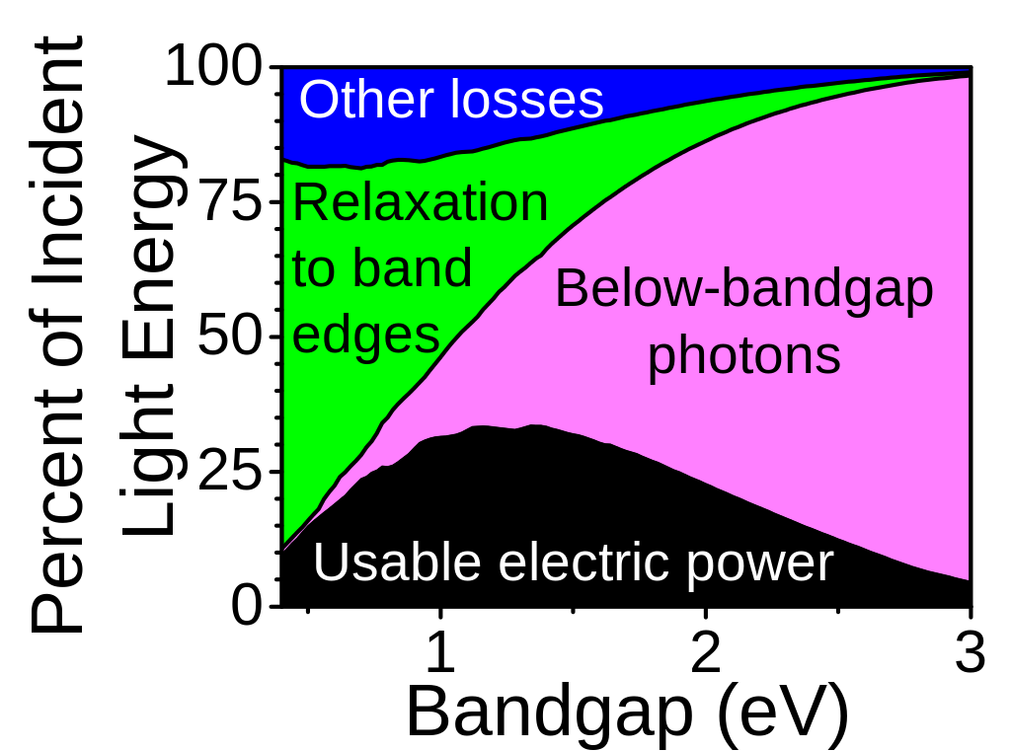
Multiple Exciton Generation

Slide 38

Quantum Yield
Notes:
To improve fluorescence quantum yield, quantum dots can be made with "shells" of a larger bandgap semiconductor material around them.
TU Dresden:
are 0.65−0.85 for CdSe,(29, 30) 0.1−0.4 for InP,(31-33) and 0.30−0.75 for CdTe and CdHgTe(34-36) as well as 0.26−0.70 and 0.1−0.8 for the NIR emitters PbS(37, 38) and PbSe, respectively.(39, 40)

Slide 39
Applications
Displays
Lasers
Photodetectors
Immunohistochemistry (Biomarkers)
Solar?

Slide 40
Future Challenges
Alternative Materials (EHS)
Tabulate band gaps
Measure/compute effective electron mass

Slide 41
References
Iafrate, G. J., K. Hess, J. B. Krieger, and M. Macucci. “Capacitive Nature of Atomic-Sized Structures.” Physical Review B 52, no. 15 (October 15, 1995): 10737–39. https://doi.org/10.1103/PhysRevB.52.10737.
Brus, Louis. “Chemistry and Physics of Semiconductor Nanocrystals,” n.d., 33.
Brus, Louis. “Electronic Wave Functions in Semiconductor Clusters: Experiment and Theory.” The Journal of Physical Chemistry 90, no. 12 (June 1986): 2555–60. https://doi.org/10.1021/j100403a003.
Kippeny, Tadd, Laura A. Swafford, and Sandra J. Rosenthal. “Semiconductor Nanocrystals: A Powerful Visual Aid for Introducing the Particle in a Box.” Journal of Chemical Education 79, no. 9 (September 2002): 1094. https://doi.org/10.1021/ed079p1094.

Slide 42
References
Pathak, Smita, Elizabeth Cao, Marie C. Davidson, Sungho Jin, and Gabriel A. Silva. “Quantum Dot Applications to Neuroscience: New Tools for Probing Neurons and Glia.” Journal of Neuroscience 26, no. 7 (February 15, 2006): 1893–95. https://doi.org/10.1523/JNEUROSCI.3847-05.2006.
Rühle, Sven. “Tabulated Values of the Shockley–Queisser Limit for Single Junction Solar Cells.” Solar Energy 130 (June 2016): 139–47. https://doi.org/10.1016/j.solener.2016.02.015.
Gilmore, Rachel H., Samuel W. Winslow, Elizabeth M. Y. Lee, Matthew Nickol Ashner, Kevin G. Yager, Adam P. Willard, and William A. Tisdale. “Inverse Temperature Dependence of Charge Carrier Hopping in Quantum Dot Solids.” ACS Nano 12, no. 8 (August 28, 2018): 7741–49. https://doi.org/10.1021/acsnano.8b01643.

